Slide 1
HealthCare Analysis
.

Slide 2
Introduction
The healthcare dataset analysis project aims to create a comprehensive Tableau dashboard utilizing a provided dataset encompasses funding for various research and disease areas, along with mortality and prevalence data specific to the year 2019.
Key Funding
In the dataset includes funding amounts for various research and disease areas from 2008 to 2024.
Research/Disease Areas with the Highest Funding: Identify the top research and disease areas that have received the most funding over the years.
Funding Trends: Analyze the finding trends to each research and disease area to identify patterns and exhanges over time.
ARRA Funding: Identify the research and disease areas that received ARRA funding and analyze the impact of this funding trends.
Estimated Future Funding: Analyze the estimate future funding for each research and disease area to identify potential areas of growth or decline.

Slide 3
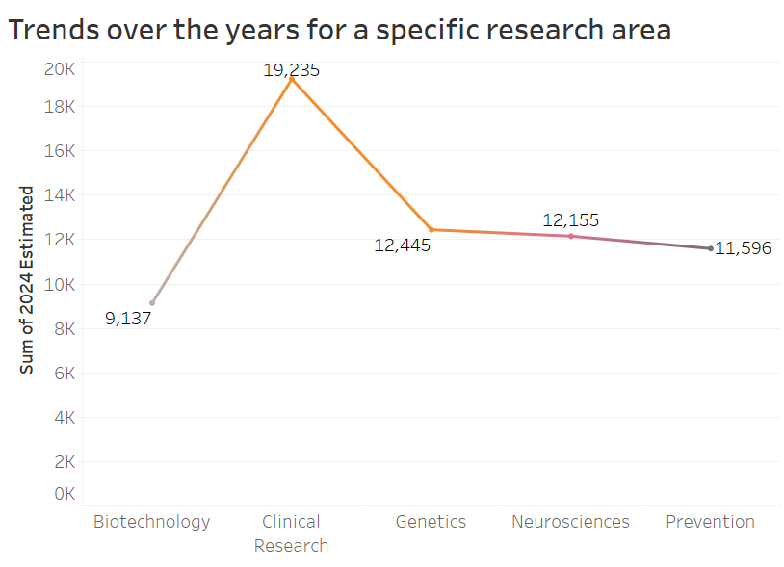
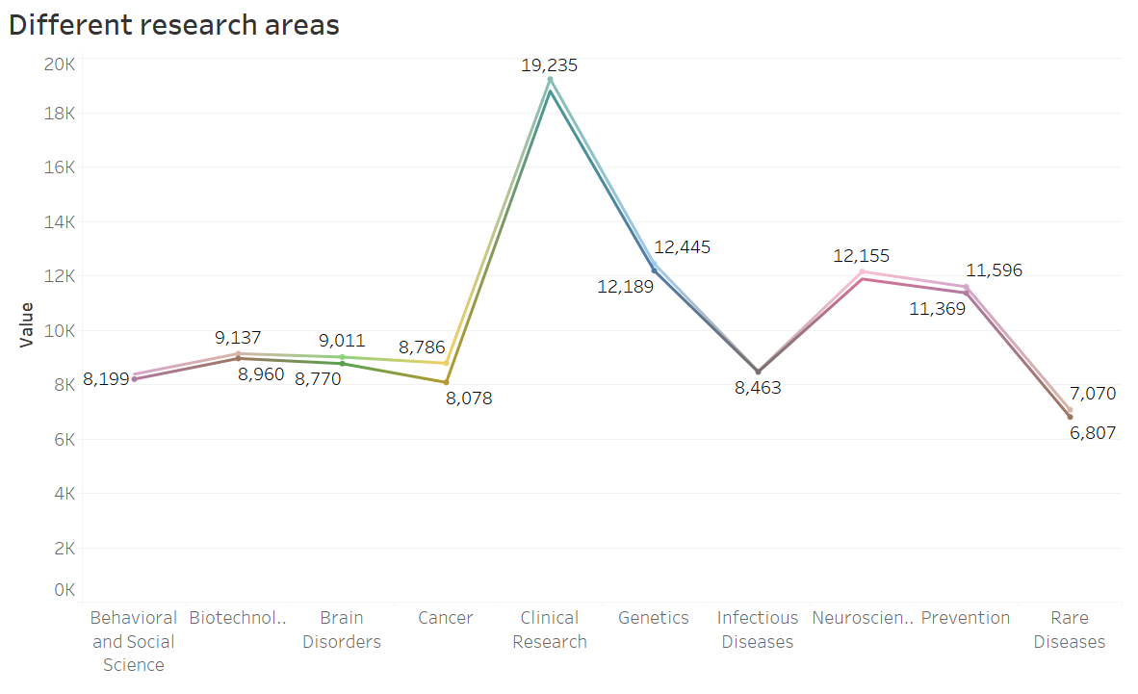

Slide 4
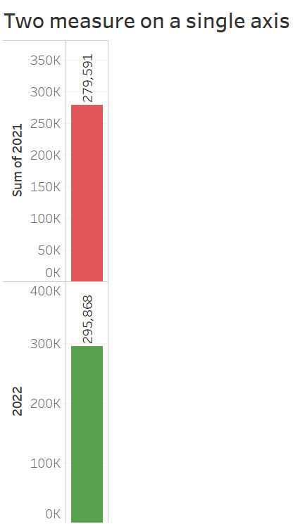
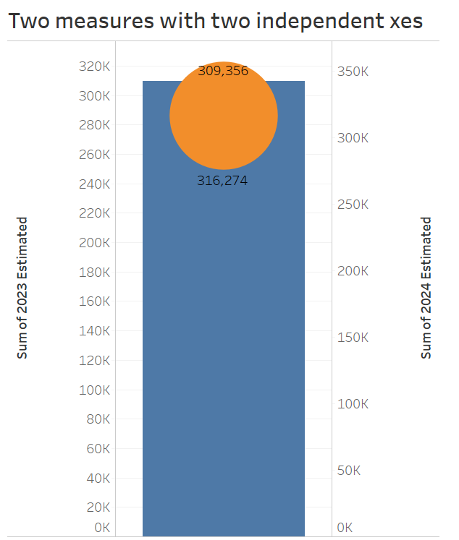

Slide 5
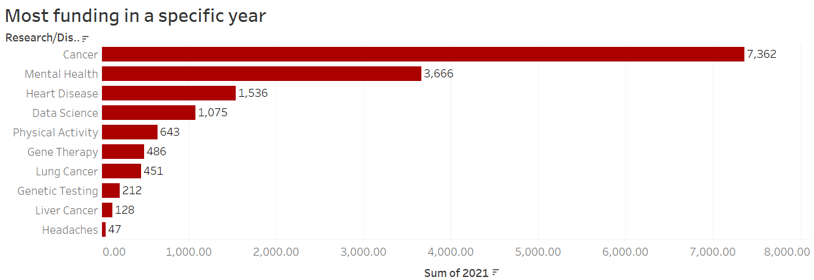
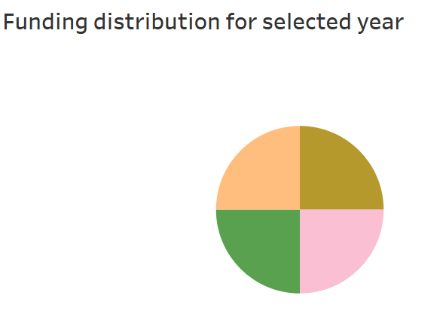
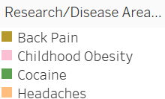

Slide 6
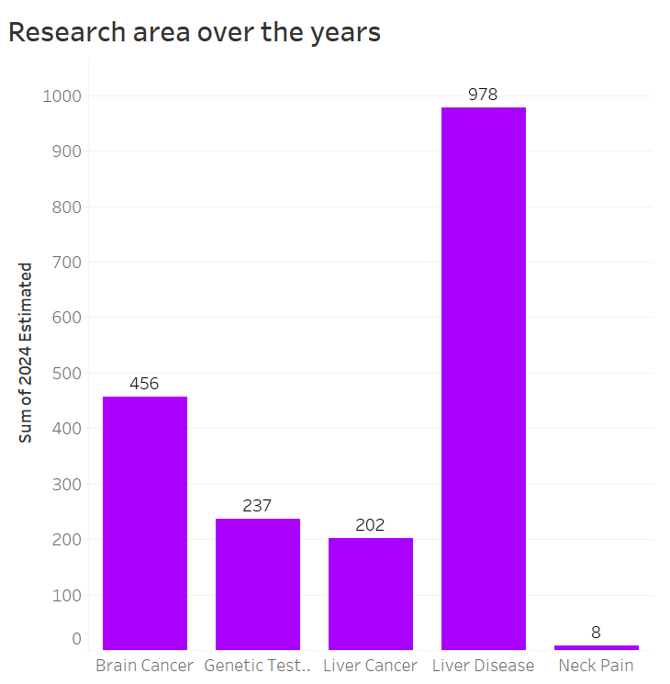
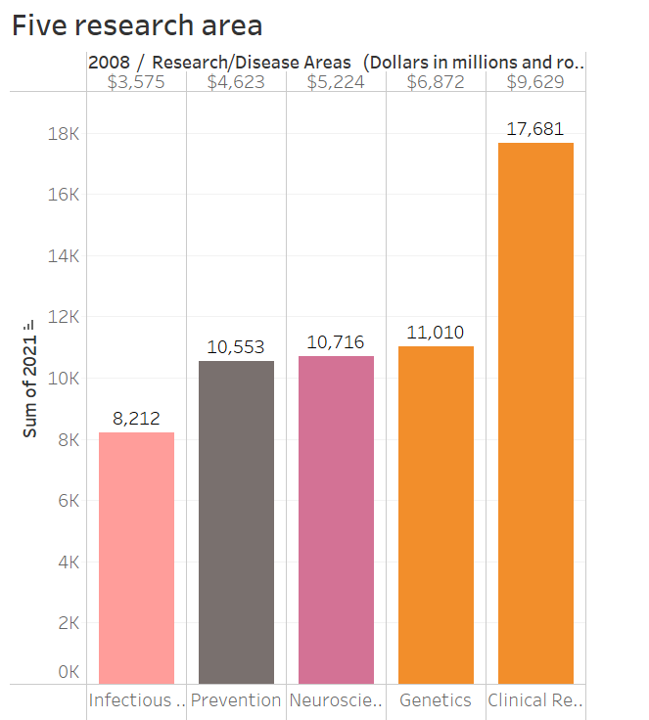

Slide 7
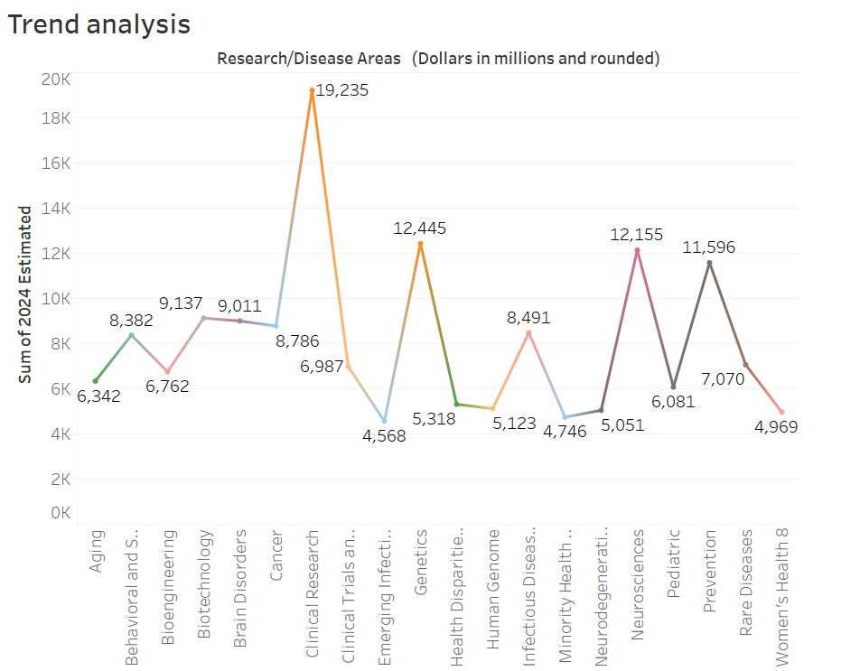
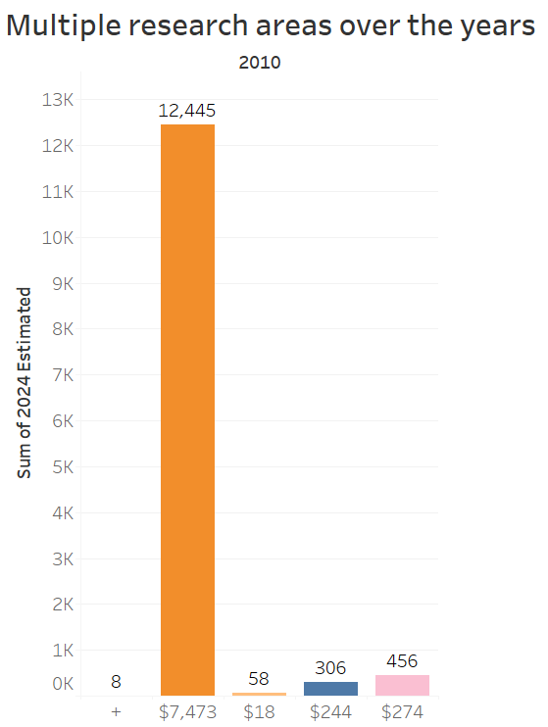

Slide 8
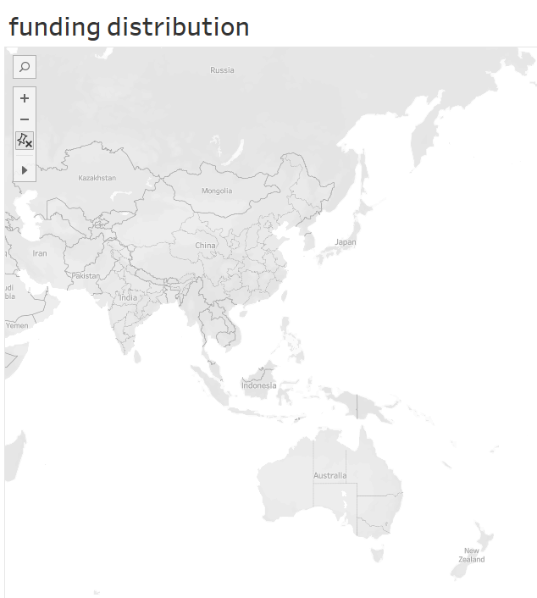
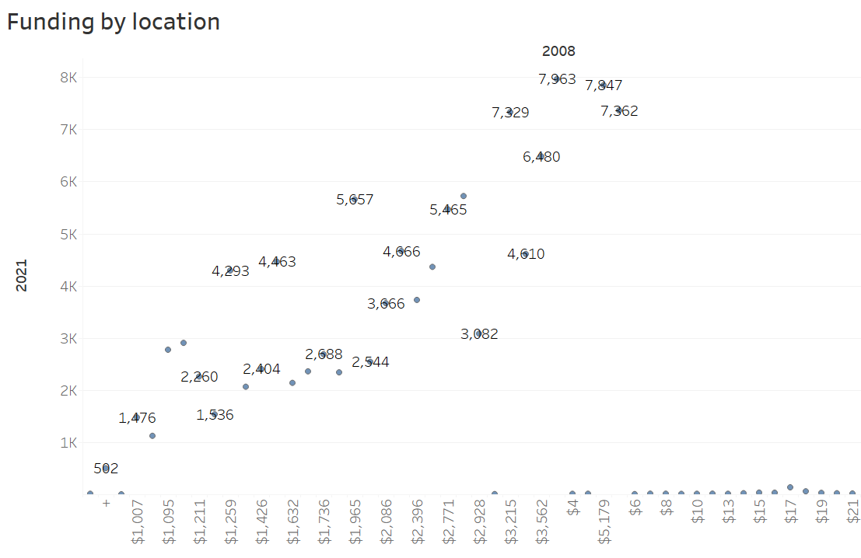

Slide 9

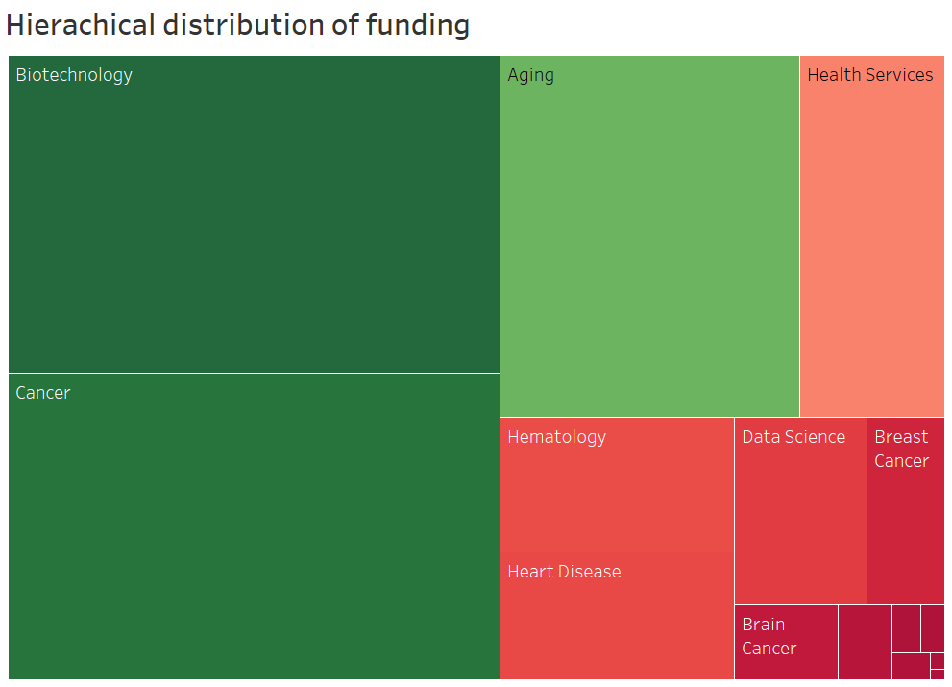
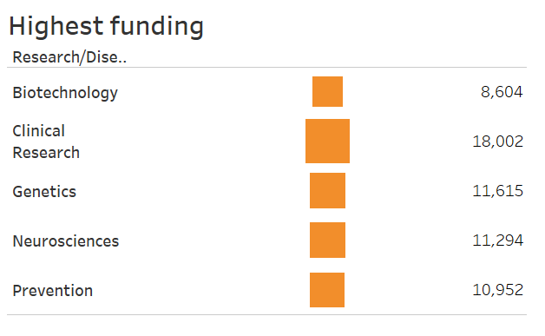

Slide 10
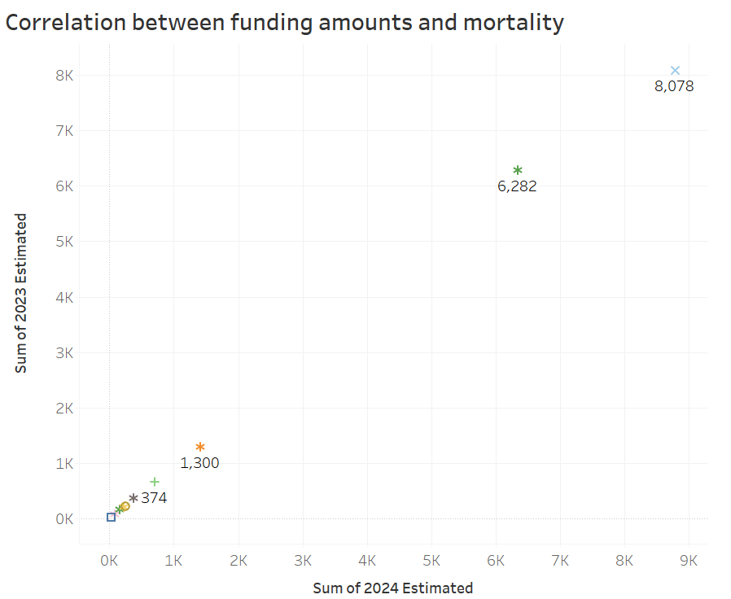
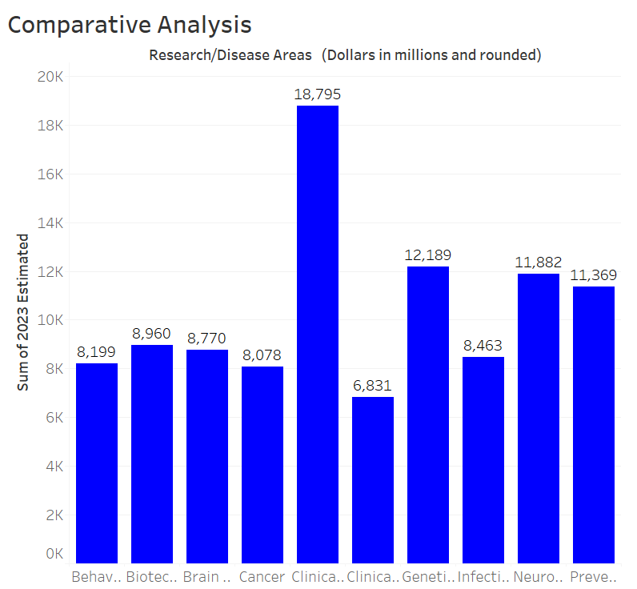

Slide 11
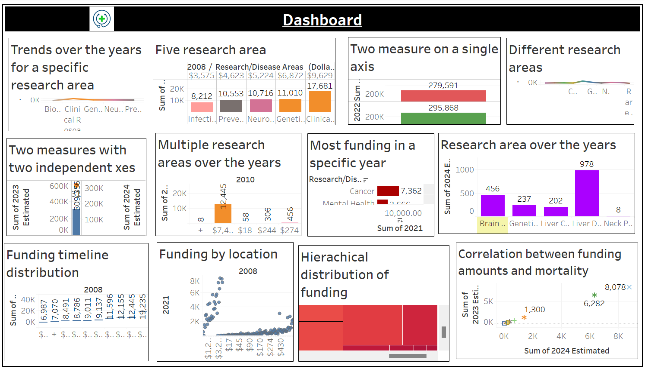

Slide 12
Actionable
Based on dataset, some examples of actionable insights might include:
Increase Funding for Cancer Research: The dataset shows a significant increase in cancer-related mortality rates over the years. Increasing funding for cancer research could lead to the development of more effective treatements and improved patient outcomes.
Invest in Neurological Disorder Research: The dataset shows a steady increase in neurological disorder-related mortality rates. Investing in research for neurological disorders such as Alzheimer’s disease and Parkinson’s disease could lead to the development of more effective treatments and improved patient outcomes.

Slide 13
Methodologies
To analyze the healthcare dataset and derive meaningful insights, the following methodologies can be employed:
Data Cleaning and Preprocessing : Ensure that the dataset is accurate, complete, and consistent by cleaning and preprocessing the data.
Data Visualization : Use data visualization techniques such as charts, graphs, and maps to represent the data in a clear and concise manner.
Statistical Analysis : Apply statistical techniques such as regression analysis, correlation analysis, and hypothesis testing to identify rends and patterns in the data.
Machine Learning : Use machine learning algorithms such as decision trees, random forests, and neural networks to identify complex patterns and relationships in the data.

Slide 14
Approaches
The following approaches can be used to analyze the healthcare dataset:
Descriptive Analytics : Use descriptive analytics to summarize and describe the basic features of the data, such as means, medians, and standard deviations.
Predictive Analytics : use predictive analytics to forecast future trends and patterns in the data, such as predicting morality rates or disease prevalence.
Prescriptive Analytics : use prescriptive analytics to provide recommendations on what actions to take based on the analysis of the data, such as identifying the most effective interventions or treatments.
Exploratory Data Analysis : use exploratory data analysis to explore and visualize the data to identify patterns, trends, and correlations.

Slide 15
Insights
The healthcare dataset provides a wealth of information that can used to inform decision-making and drive action.
Funding Trend : The dataset shows that funding for healthcare research has increased over the years, with a significant increase in funding for cancer research.
Mortality rates : The dataset shows that mortality rate for certain diseases, such as heart disease and cancer, have decreased over the years, while mortality rates for other diseases, such as Alzheimer’s disease, have increased.
Disease Prevalence : The dataset shows that the prevalence of certain disease, such as diabetes and obesity, has increased over the years, while the prevalence of other diseases, such as HIV/AIDS, has decreased.
Research Areas : The dataset shows that research areas such as cancer, infectious diseases, and neurological disorders have received significant funding over the years.

Slide 16
Conclusion
The healthcare dataset provides a comprehensive overview of funding trends, mortality rates, and disease prevalence over the years. By analyzing this dataset, researchers and policymakers can gain valuable insights into the current state of healthcare research and identify areas for improvement.

